Slide 1
dGLN3 Stem Results

Slide 2
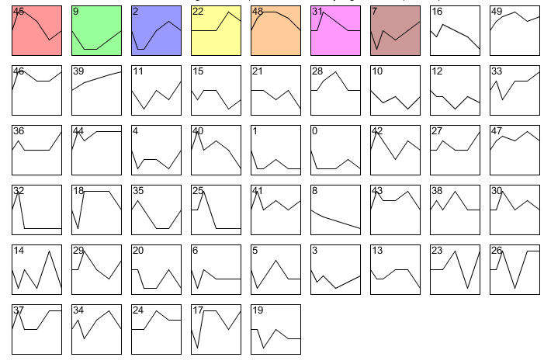
dGLN3 all stem profiles

Slide 3
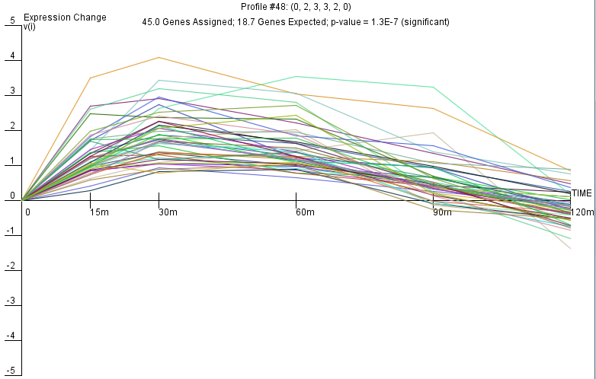
dGLN profile 48

Slide 4
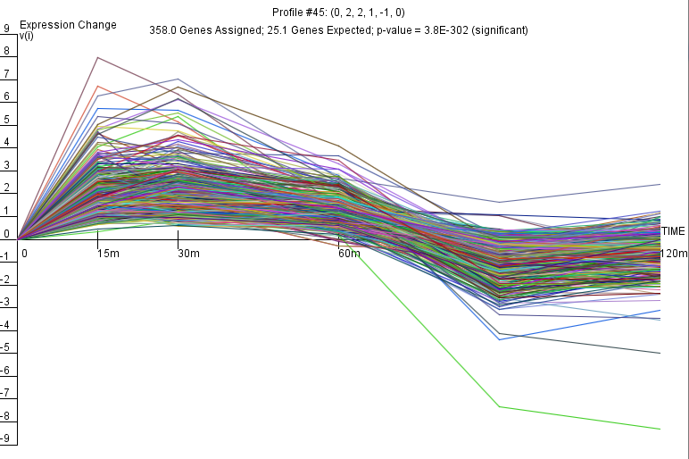
dGLN3 profile 45

Slide 5
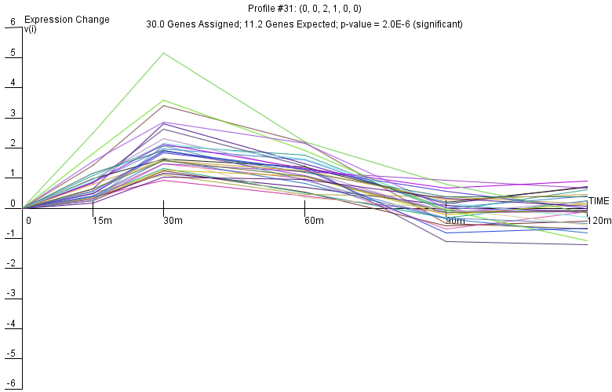
dGLN3 profile 31

Slide 6
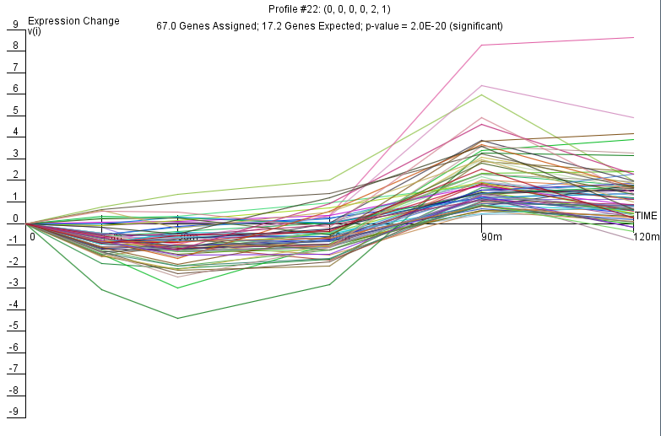
dGLN3 profile 22

Slide 7
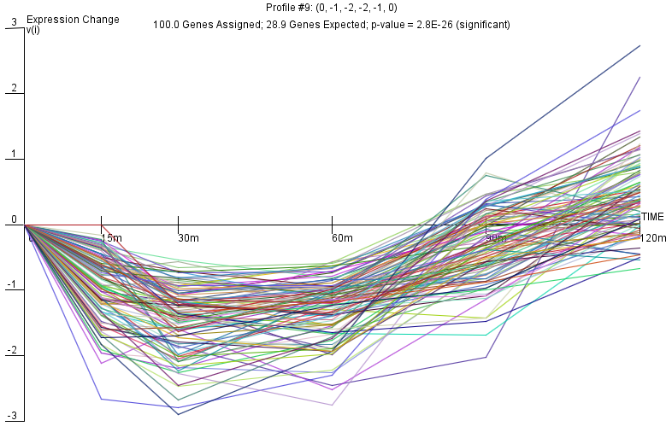
dGLN3 profile 9

Slide 8
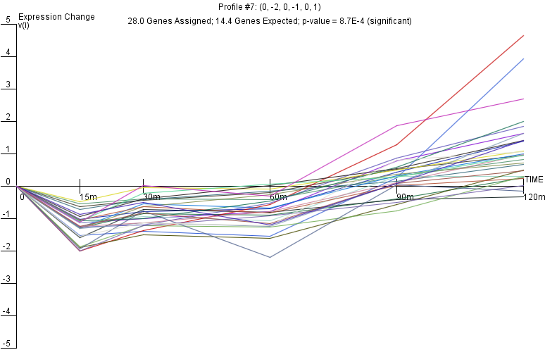
dGLN3 profile 7

Slide 9
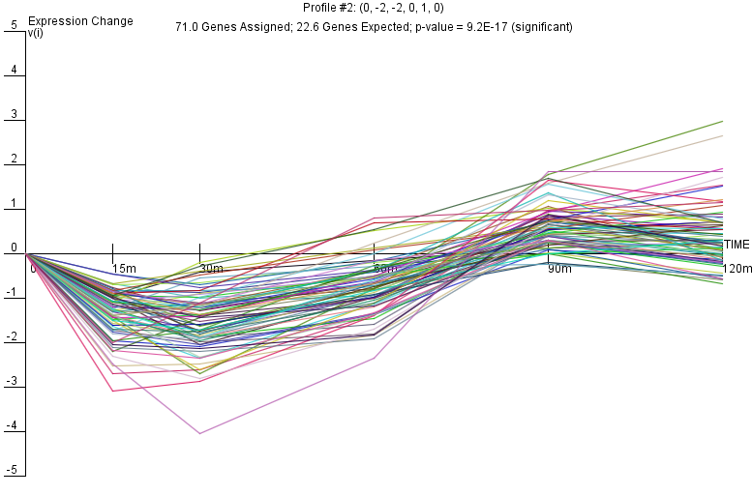
dGLN3 Profile 2

